Slide 1
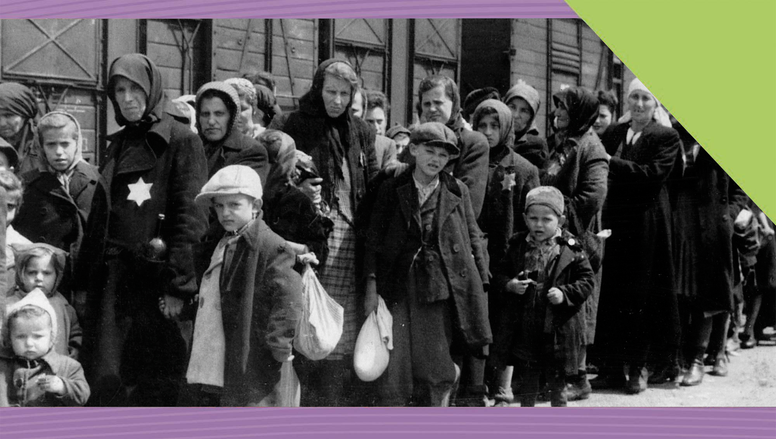
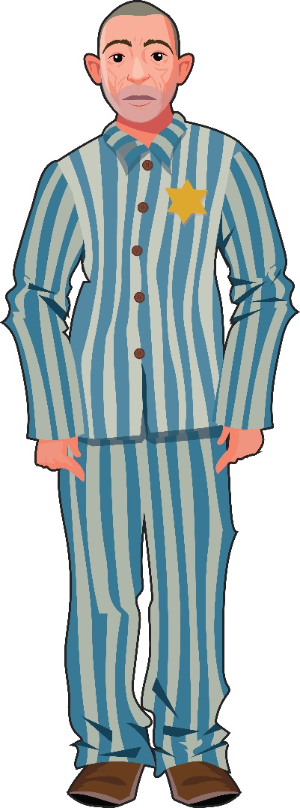

The Holocaust
20
Causes, Course and Consequences
Making History (2nd Edition)

Slide 2
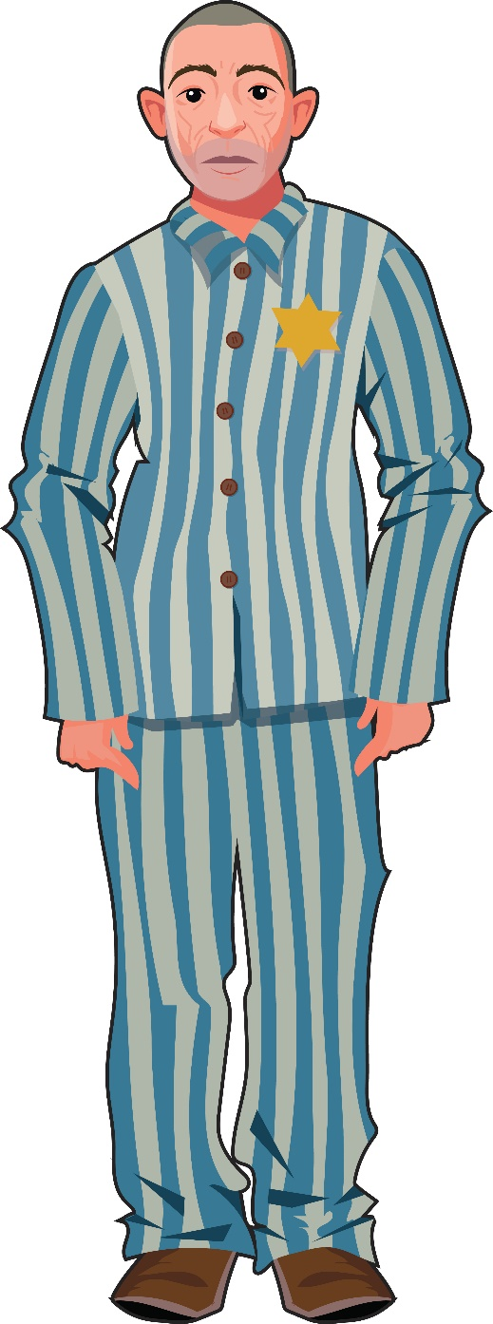
What Will I Learn?
Discuss the significance of genocide
Explore the causes, course and consequences of the Holocaust
Explore the Nature of History

Slide 3
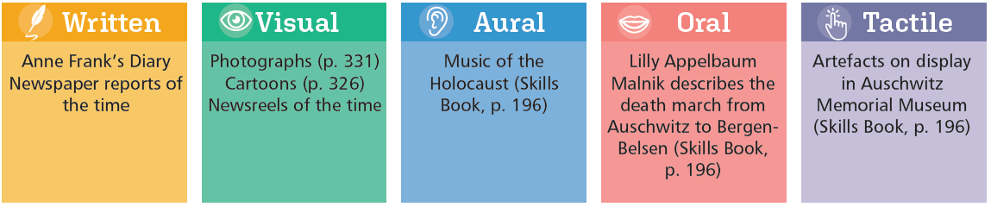
Sources for the Study of the Holocaust

Slide 4
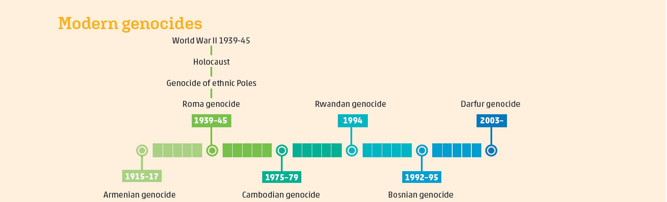
Timeline

Slide 5
Key Words
Anti-Semitism | hatred of the Jews
Concentration camps | camps set up by the Nazis in Germany or Communists in the Soviet Union (gulags) to imprison opponents
Discrimination | unjust treatment of different people, usually based on race, religion or sex
Extermination camps | camps organised by the Nazis in Poland during World War II for killing Jews
Final Solution | Hitler and the Nazis’ policy during World War II of killing all Jews
Genocide | the deliberate killing of a large group of people, especially those of a particular nation or ethnic group
Ghetto | a separate area of a city occupied by people of one particular race or religion
Holocaust | the systematic slaughter of European Jews by Nazi Germany during World War II
Master Race | Nazi term for pure and superior white race who aimed to dominate or rule the world
Nuremberg Laws | Nazi laws against the Jews that deprived them of German citizenship, banned marriages with non-Jews and forced them to wear the Star of David
Pogrom | an organised massacre and persecution of an ethnic or religious group, usually applied to attacks on the Jews in Russia and Nazi Germany
Racism | belief that race decides a person’s character and that some races are superior to others; prejudice against someone of a different race based on these ideas

Slide 6
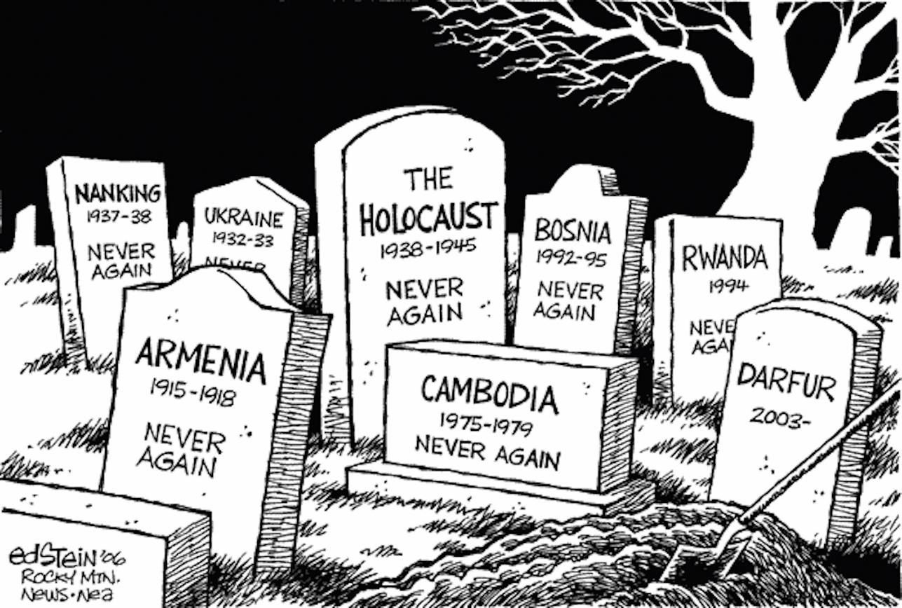

What is the Significance of Genocide?
Armenian genocide
The Holocaust
Other WWII genocides
Khmer Rouge, Cambodia
Rwandan massacre
Bosnian genocide
Darfur genocide
What is genocide?
Genocide is the deliberate killing of a large number of people, particularly from a different nation or ethnic group.
Do you think all of the examples in this cartoon are genocides?

Slide 7
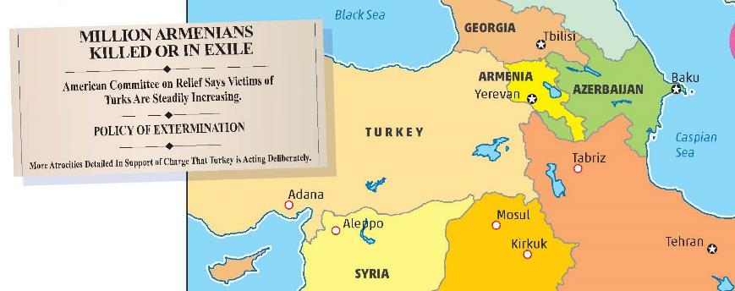
Are All These Examples of Genocide in the Modern World?
Armenian Genocide

Slide 8
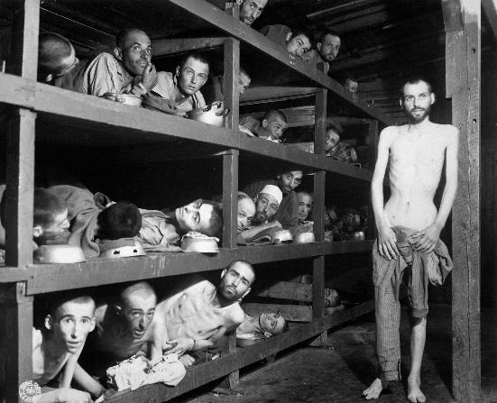
Are All These Examples of Genocide in the Modern World?
The Holocaust
Other WWII genocides
Poles
Roma

Slide 9
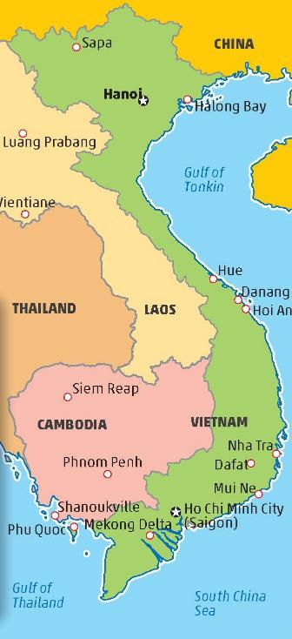
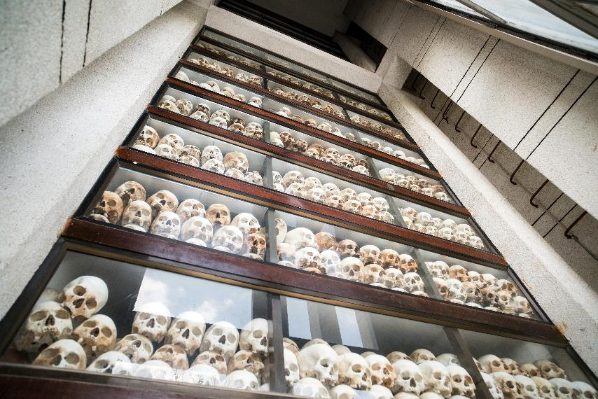
The Khmer Rouge in Cambodia
Skulls of the people killed in the Killing Fields on display at a memorial centre in Cambodia

Slide 10
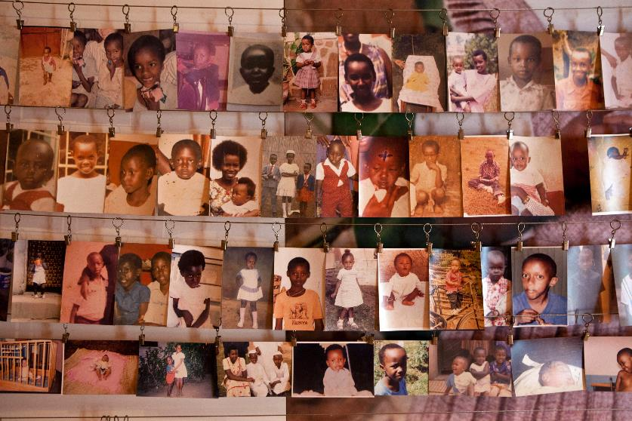
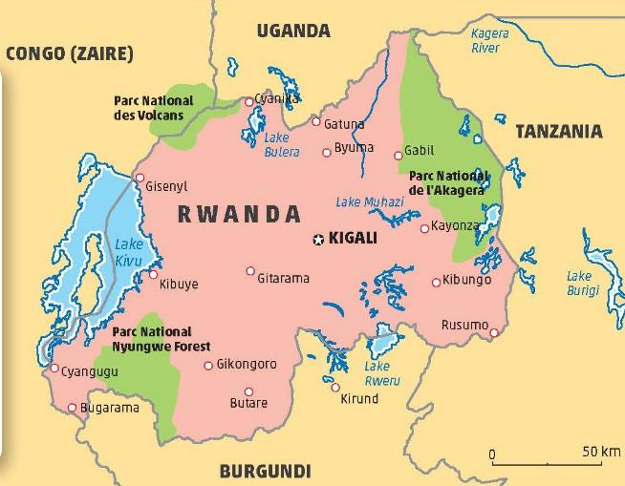
Rwandan Massacre
Photographs of children killed in the Rwandan Massacre

Slide 11
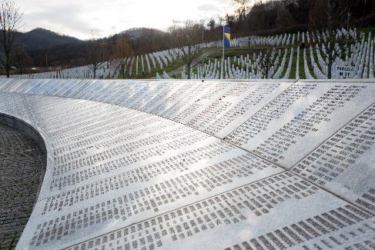
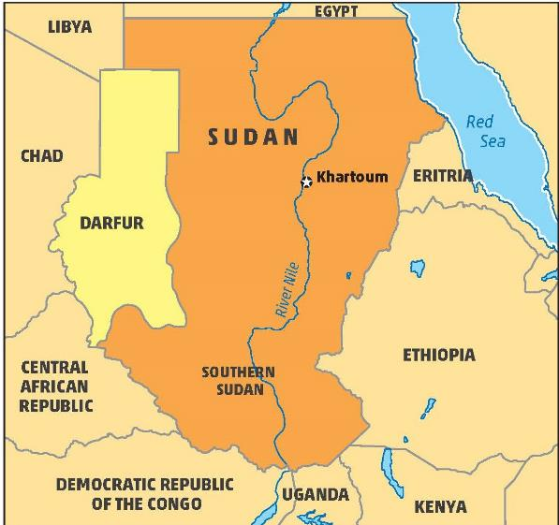
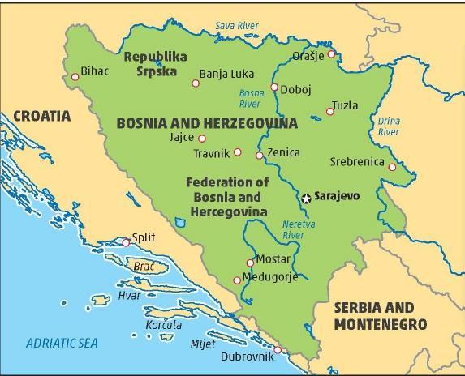
Bosnian Genocide
Darfur Genocide
Names of the killed on the Srebrenica Genocide Memorial

Slide 12

Select one of the genocides of the 20th or 21st centuries (except the Holocaust) and research its causes (why it happened) and consequences (the results of what happened).
Assessing Your Learning

Slide 13
Assessing Your Learning
Which of these sources are primary sources: Anne Frank’s Diary; artefacts on display in the Holocaust History Museum; Lilly Appelbaum Malnik’s description of the death march from Auschwitz to Bergen-Belsen? Explain your answers.
Complete this sentence: Genocide is the deliberate killing of a large number of people …
What is the meaning of ‘deliberate’?
What ‘large number of people’ does genocide refer to?
Put the genocides listed above in order of the number of people killed, beginning with the largest number.

Slide 14
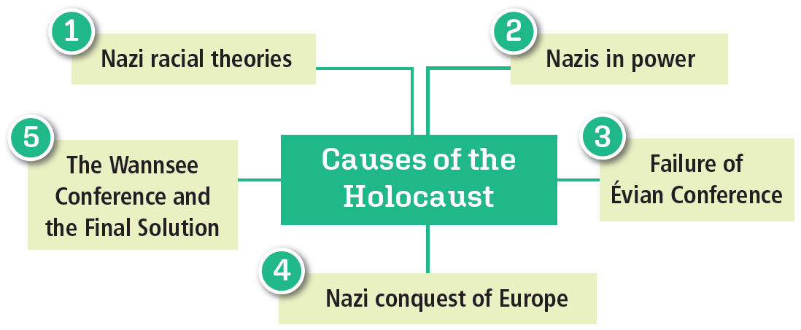
What Were the Causes of the Holocaust?
Holocaust – the deliberate killing of millions of Jews by the Nazis during World War II

Slide 15

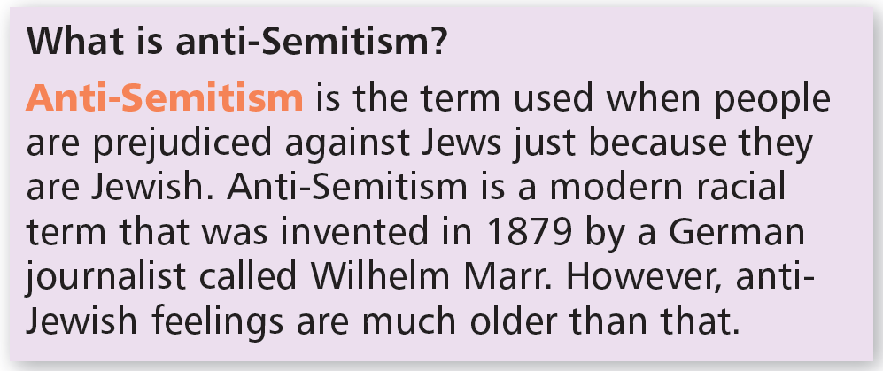
The Nazi racial theories
Racism – the view that all human characteristics (features), such as intelligence and creativity, were handed down through race
Master Race – They Nazis said Germans were the Master Race
They were the superior Aryan race
They said Jews were ‘inferior’, ‘parasitic’ (living off other people)
Nazis hated the Jews – anti-Semitism
Hitler’s views
Hitler remarked: ‘Out with the Jews from all the professions and into the ghetto with them; fence them in somewhere they can perish as they deserve while the German people look on, the way people stare at wild animals.’
General Wiedemann, Hitler’s adjutant, 1935

Slide 16

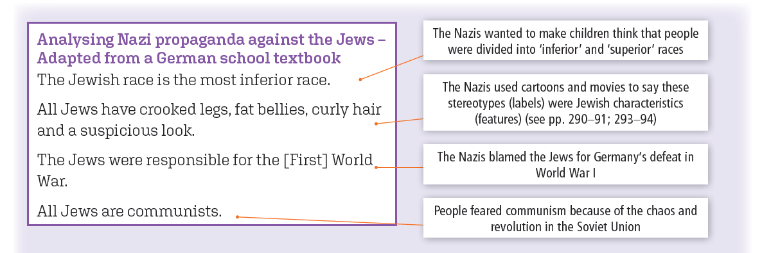
The Nazis in power
Anti-Semitic propaganda in newspapers, school text books and movies
Nuremberg Laws
Pogroms, boycott, arrest
Night of the Broken Glass
30,000 Jews imprisoned in concentration camps, Dachau and Buchenwald

Slide 17

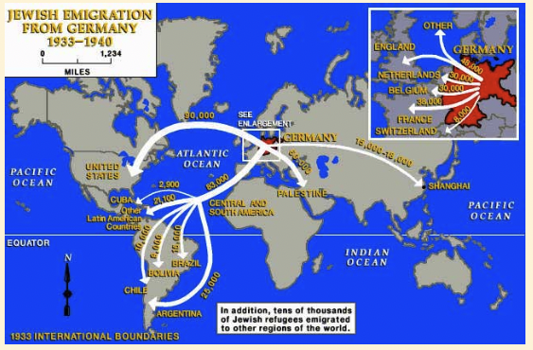
The failure of the Évian Conference
Thousands of Jews emigrated from Germany
32 countries met in Évian in France (1938) to discuss Jewish immigration from Nazi Germany
All countries (except Dominican Republic) refused to take more Jewish emigrants
Germany concluded other countries were not prepared to help the Jews.
Nazis move towards their own ‘solution’ - extermination
Source: www.jewishvirtuallibrary.org/jewish-emigration-from-germany-1933-1939

Slide 18
Assessing Your Learning
Racism is … (i) the belief that race decides a person’s character (ii) the belief that some races are superior to others (iii) the belief that all races are equal?
The Nazis said the Germans were (i) the Master Race (ii) the Aryan race (iii) the superior race (iv) the race of low culture?
The Nazis said the Jews were (i) an inferior race (ii) the race of high culture (iii) like parasites?
Apart from the Jews, name two other ethnic groups the Nazis directed their hatred toward.
What was the connection between the crucifixion of Jesus and the rise of anti- Semitism?
Give one example of anti-Semitic propaganda used by the Nazis.
Revise the Nuremberg Laws on p. 293.
What was the Évian Conference?
Was the Évian Conference successful?

Slide 19

The Nazi Conquest of Europe
In WWII, Nazis conquered large parts of Europe
Millions of Jews captured
Number of concentration camps increased
1,000 concentration camps
Jews and other ‘enemies of the state’ – Jehovah’s Witnesses, Roma, political opponents, people with disabilities
Jews herded into ghettoes in cities
e.g. the Warsaw Ghetto
Thousands died of hunger, disease, harsh treatment
Plan to export Jews to Madagascar – dropped
SS killing squads executed thousands of Jews in conquest of Soviet Union
e.g. Babi Yar massacre near Kyiv (Ukraine)
Jewish population in 1933 in countries conquered by Germany before and during WWII
Poland | 3,000,000
Soviet Union | 2,525,000
Romania | 756,000
Lithuania | 155,000
Hungary | 445,000
Czechoslovakia | 357,000
Austria | 191,000
Total (inc. other countries) | 8.2 million

Slide 20
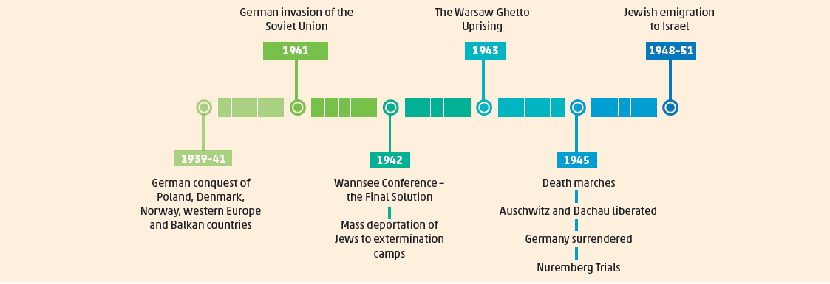
Timeline of the Holocaust

Slide 21

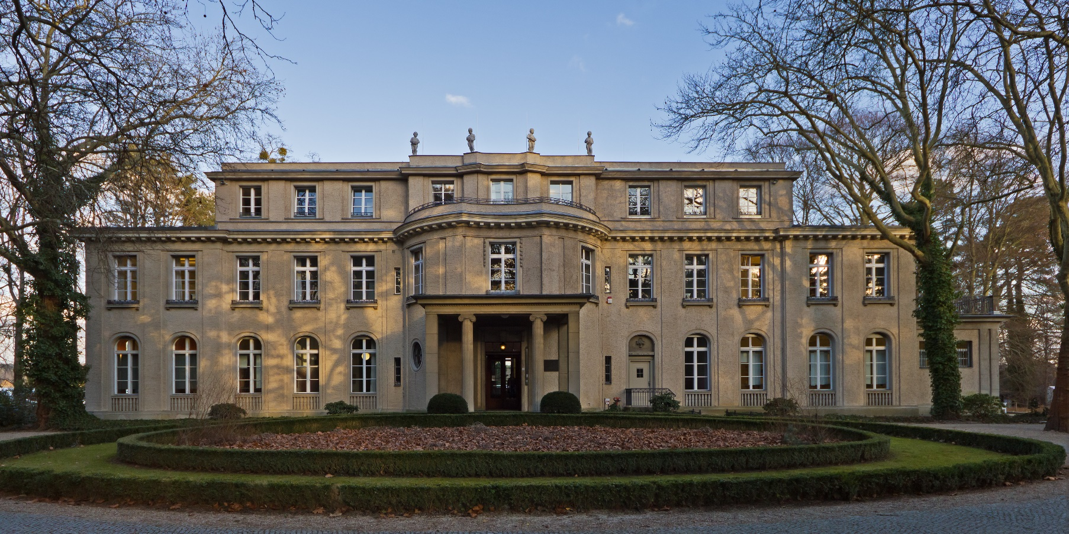
The Wannsee Conference and the Final Solution
Hitler decided there would be a Final Solution to the Jewish question
He would exterminate (kill) all European Jews
Wannsee Conference (January 1942) held to organise the ‘Final Solution of the Jewish Question’ (mass killing)
15 top-ranking Nazi officials
Jews to be transported to 6 extermination camps built in Poland
Where Wannsee Conference was held – now a memorial and museum

Slide 22
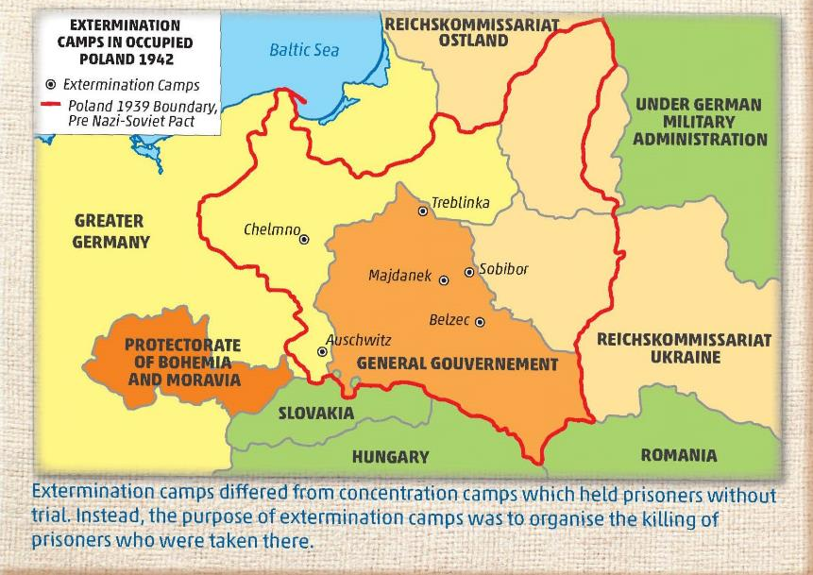
The Extermination Camps
Mass killings
Nazis experimented with ways of carrying out mass killings cheaply
Exhaust fumes from vans and stationary engines
Poisonous gas – Zyklon-B
Mass graves dug
Cremation in ovens
Death marches
Near end of war, Himmler ordered that remaining Jews and others be forced marched to Germany
SS destroy evidence of massacres
Many marchers shot or died of starvation

Slide 23
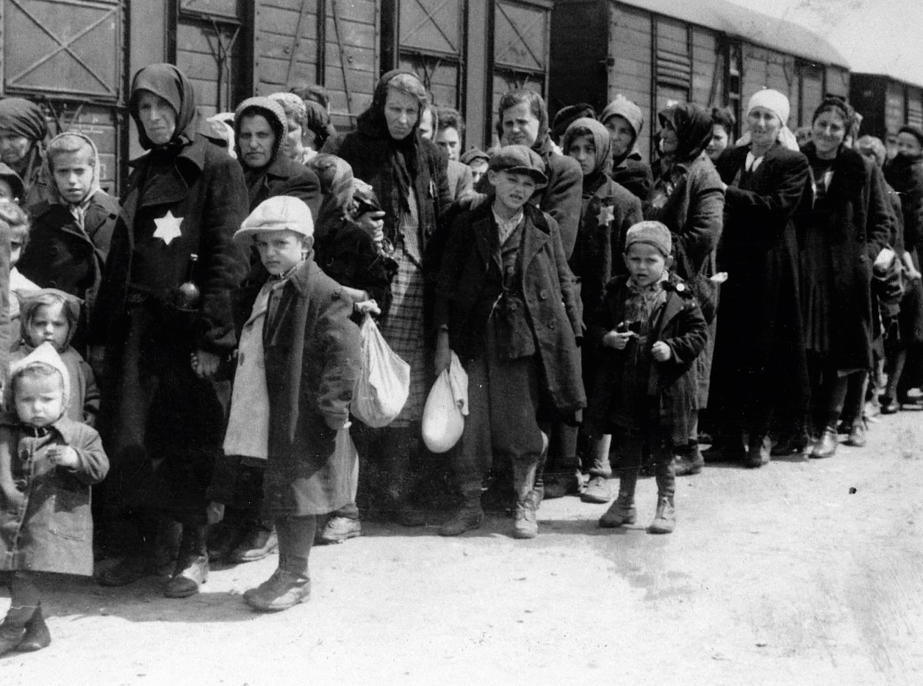
The Extermination Camps
Auschwitz
At Auschwitz the incoming prisoners would be marched past one of the doctors, who would make spot decisions as they walked by. Those who were fit for work were sent into the camp. Others were sent immediately to the extermination plants. Children were always exterminated since because of their youth they were unable to work.
(Rudolf Höss, commandant of Auschwitz extermination camp, captured by the British at the end of the war)
Belzec
After the train arrived, a loudspeaker gave instructions: ‘Strip, even artificial limbs and glasses. Hand all money and valuables in at the ‘valuables’ window. Women and young girls are to have their hair cut in the ‘barber’s hut’…’ Stark naked men, women, children and cripples passed by. SS pushed them into the gas chambers. ‘Fill it up’, (Captain) Wirth ordered. 700 to 800 people in 93 square metres. All were dead after thirty-two minutes [from the exhaust gases of the diesel engine]. …
(Kurt Gerstein, a Nazi officer in Belzec extermination camp, giving evidence at the war crimes trials after the war)
Jewish families sent by train to extermination camps
What can be learnt about the Holocaust from these sources?

Slide 24
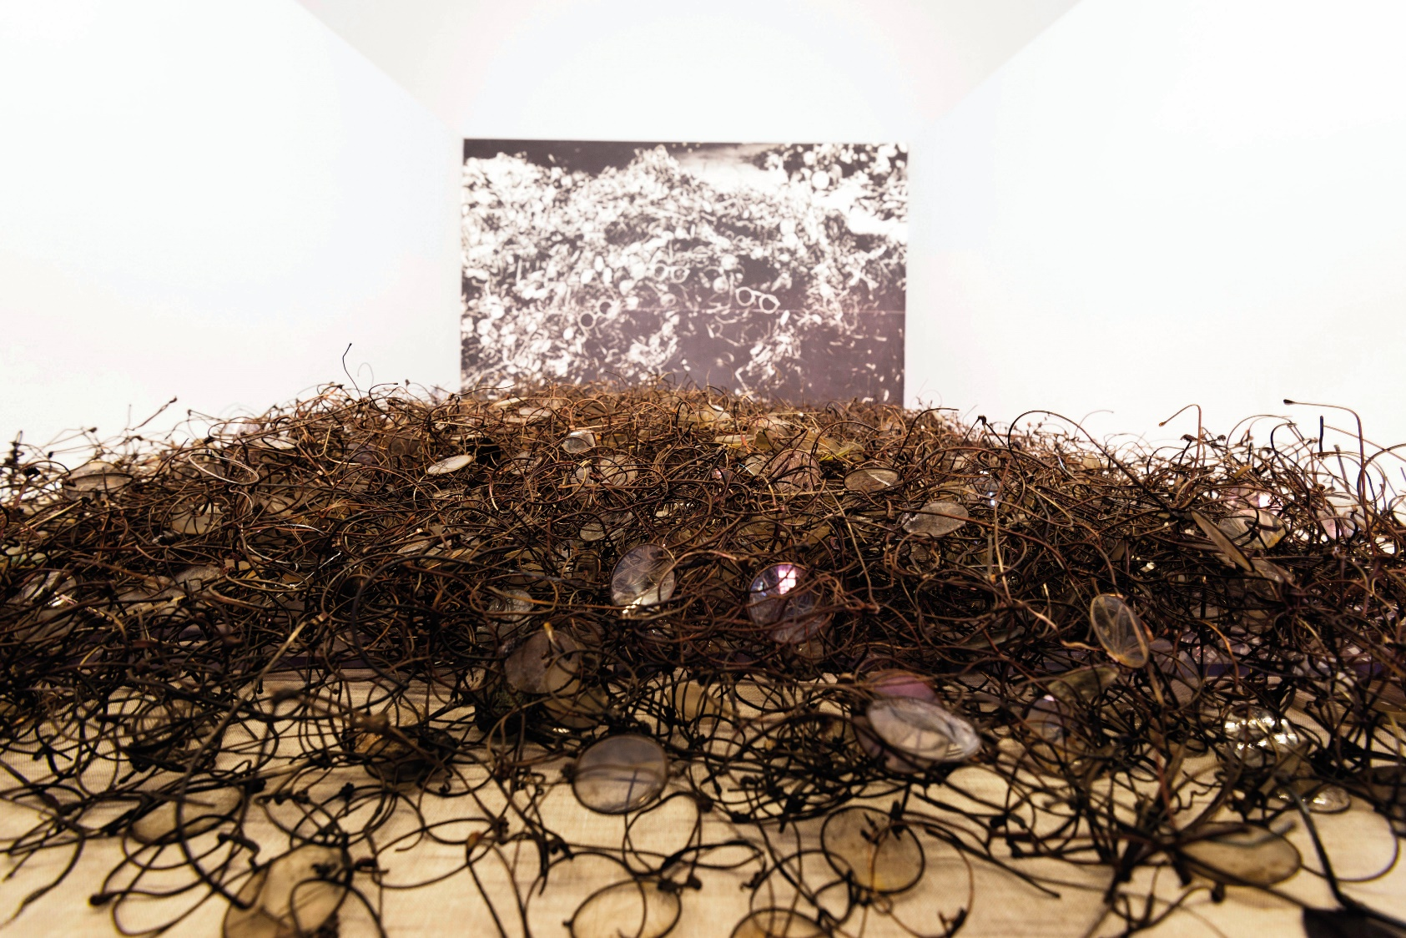
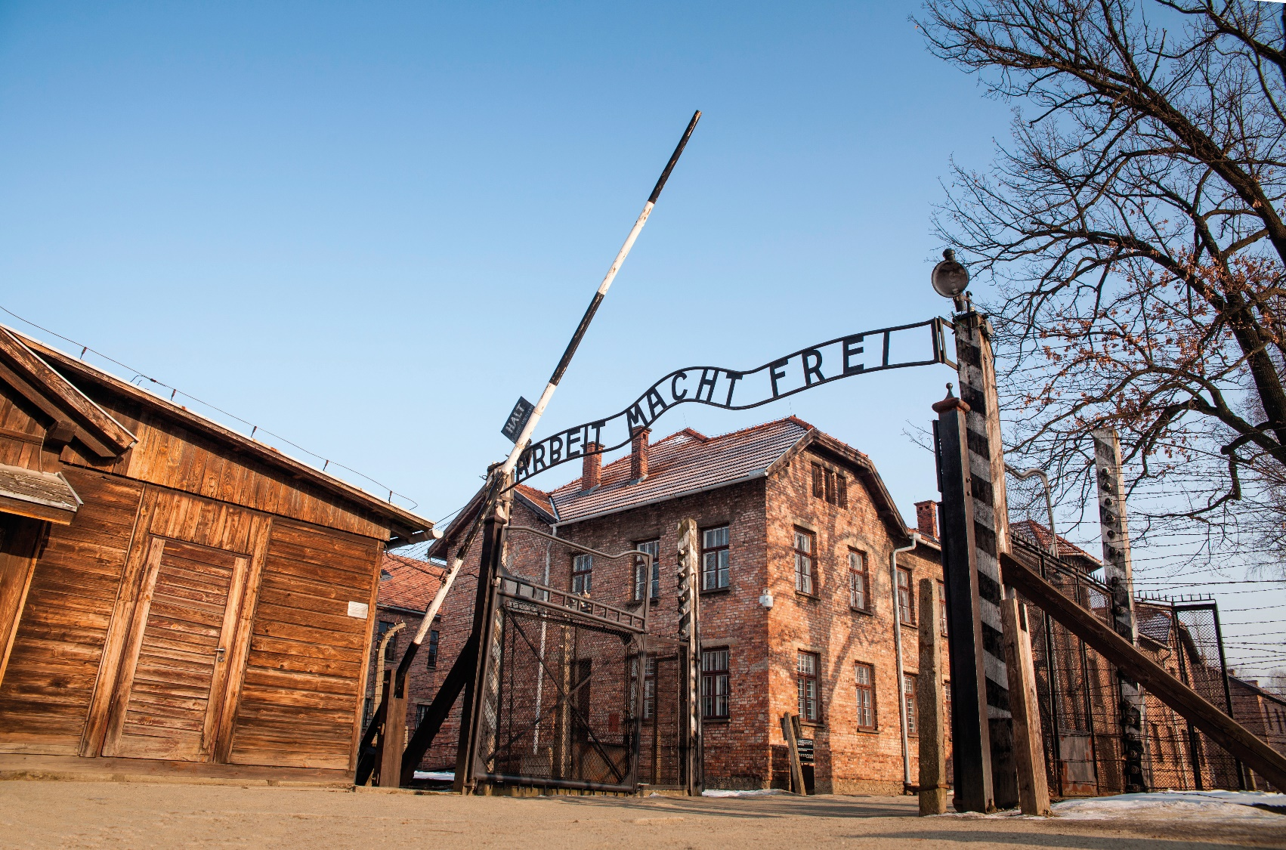
The Extermination Camps
Estimated Deaths in the Extermination Camps
Auschwitz | 1,100,000
Belzec | 434,000
Treblinka | 925,000
Sobibor | 200,000
Chelmno | 156,000 – 172,000
Majdanek | 80,000
Glasses collected from Jews before they were gassed at Auschwitz.
The entrance to Auschwitz
‘Arbiter Macht Frei’ - ‘Work sets you free’

Slide 25
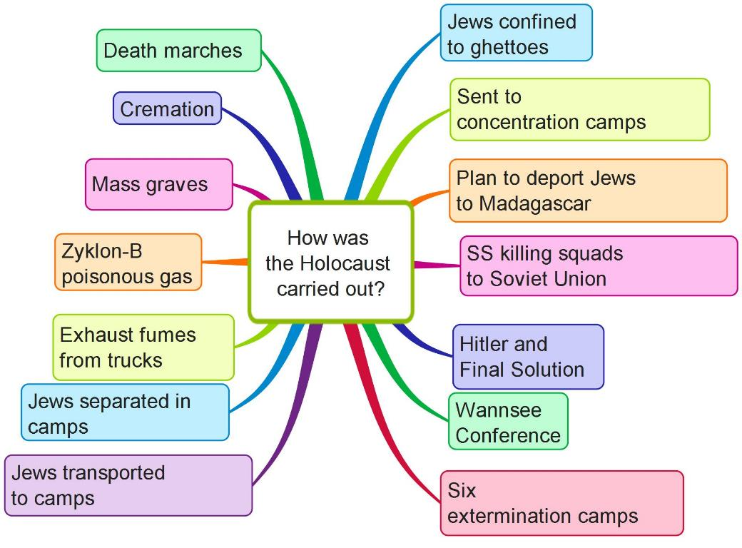
How Was the Holocaust Carried Out?

Slide 26
Assessing Your Learning
When were the number of concentration camps expanded hugely?
Give two examples of what Nazis called ‘enemies of the state’.
What are ghettoes?
Where was the largest ghetto?
What did the Nazis intend to do with Madagascar?
Where were killing squads used by the Nazis?
What happened at the Wannsee Conference?
Where were the extermination camps located?
How did the Nazis plan to kill the Jews?
What order did Himmler give as the Allied troops advanced toward Germany?
What were the death marches?

Slide 27
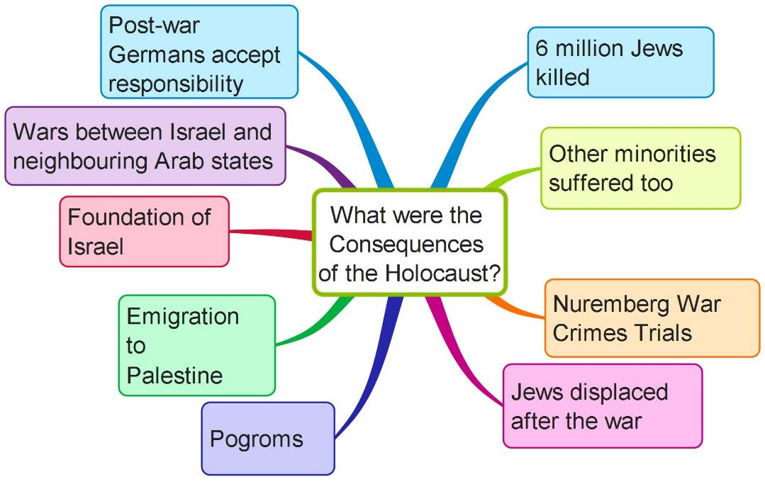
What Were the Consequences of the Holocaust?
Create your own mind map on the Consequences of the Holocaust using the above features (see MH pp. 333–334)

Slide 28
Assessing Your Learning
How many million Jews were killed in the Holocaust?
Why were Nazi leaders tried in Nuremberg?
Who were displaced persons after World War II?
What happened to Jews who survived World War II?
How was the state of Israel founded?
Who were involved in wars with Israel from 1948 onward?
What is Holocaust denial?

Slide 29
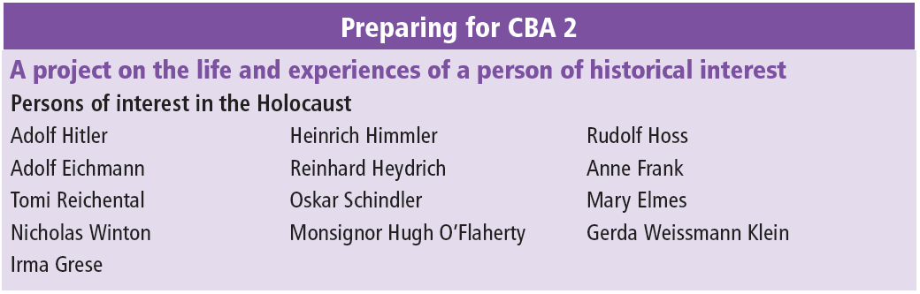
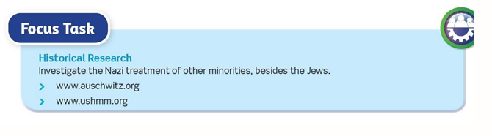
Preparing for CBA 2

